Slide 1

Car Accident Severity
Xinkai Yip

Slide 2
The ability to predict car accident is valuable for road users and the Department of Transportation
There is a 34% increase in the risk of fatal crash when precipitation is falling.
Seattle is one of the states that has a lot of precipitation in United States.

Slide 3
Data sources
Data was obtained from Seattle City Geo Data
It records all types of collisions from year 2004 to Present.
There are 194,673 rows and 38 columns in the raw dataset.
Duplicate and irrelevant datasets were dropped.
Datasets with incomplete data were dropped as well

Slide 4
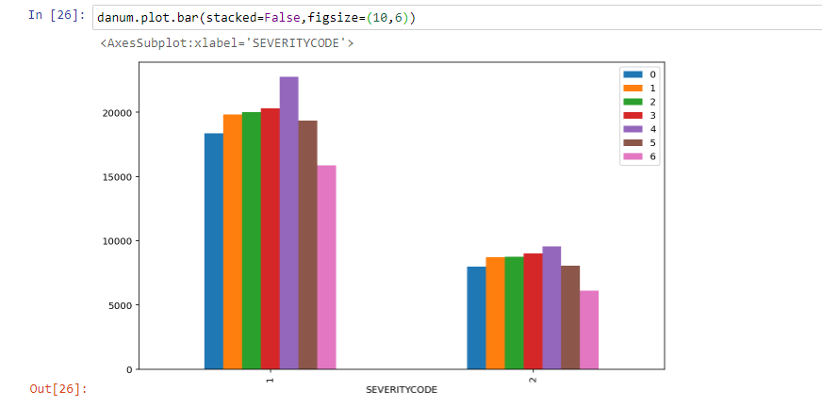
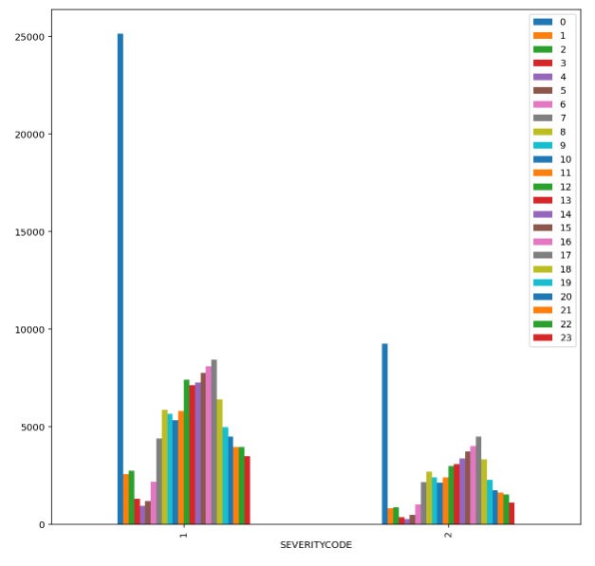
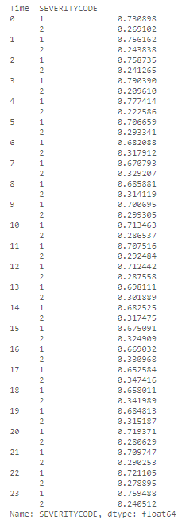
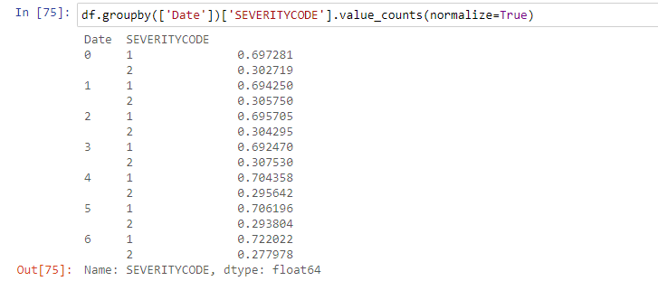
Data analysis
The Date and Time of accident data were not unique enough to predict the severity of the accident. It was dropped.

Slide 5
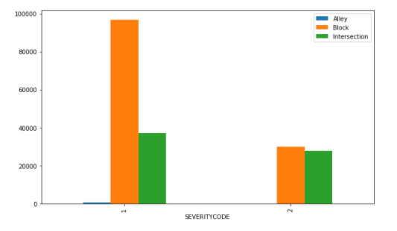
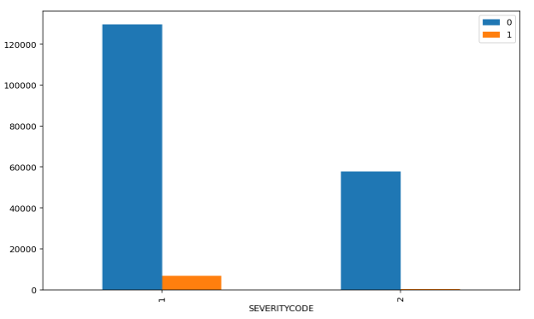
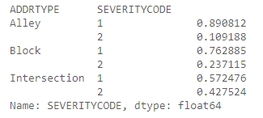
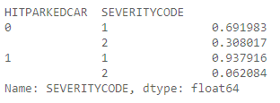
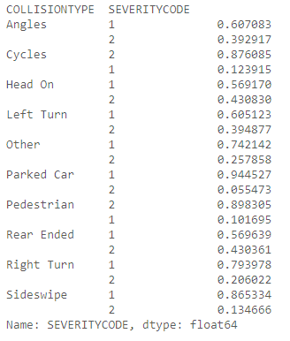
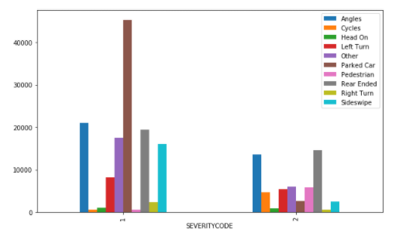
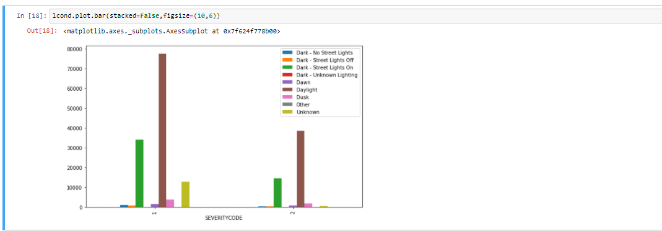
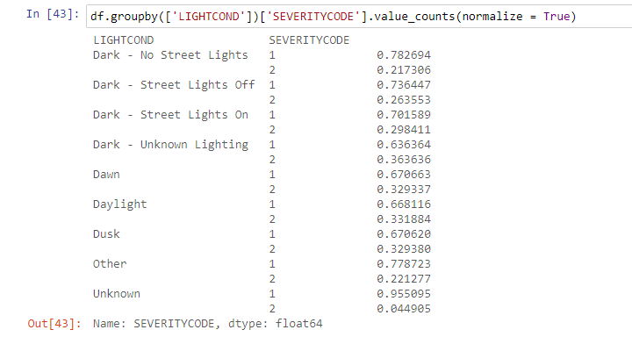
Data such as Junction Type, Collision Address Type, Collision Type, Light Condition, Road Condition, and Weather were included in data modeling

Slide 6
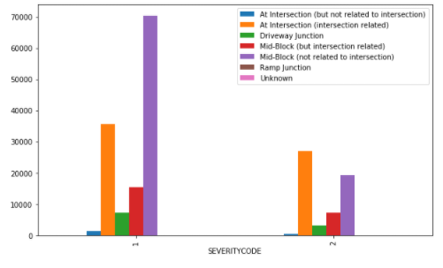
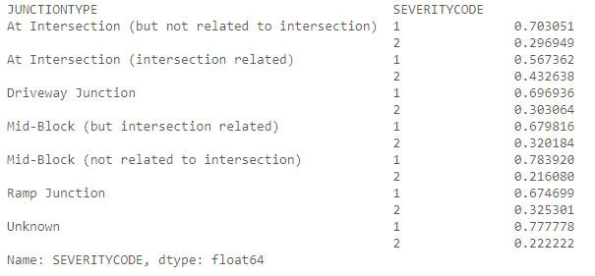
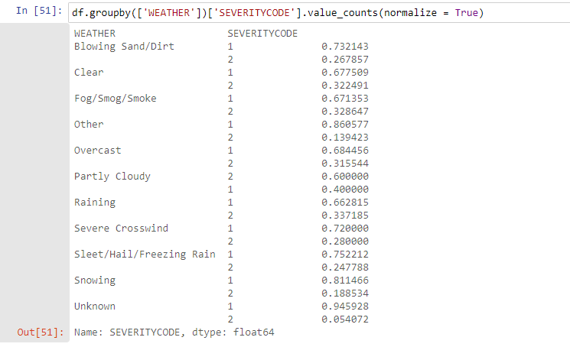
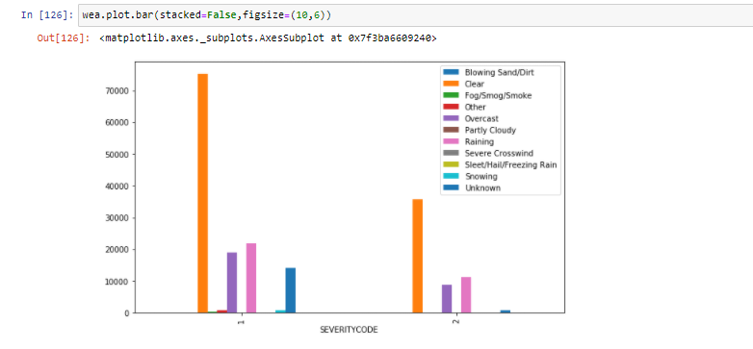
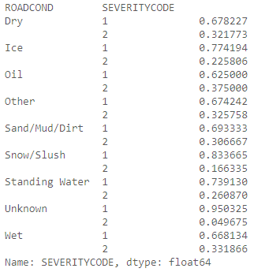
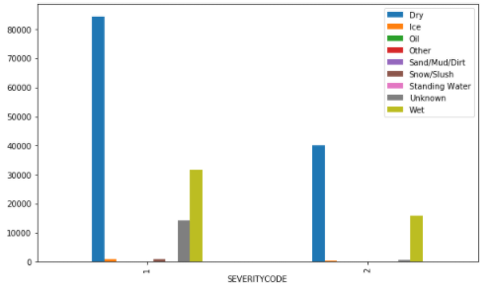

Slide 7
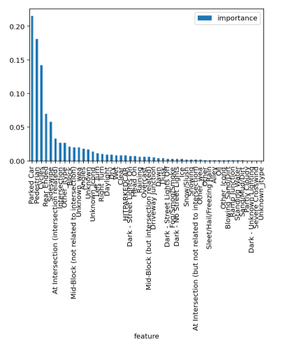
Results
Decision Tree results with depth = 3
Training accuracy: 68.93%
Testing accuracy: 84.93%
Random Tree results:
Training accuracy: 75.28%
Testing accuracy: 75.05%
The graph shows the importance of features relative to all features using Random Tree.

Slide 8
Conclusion and further studies
There could be more data that be excluded from the data modeling such as weather.
Data collection could be more robust as to not leave out any unknown data.

